Slide 1



SUBJECT:- MARKETING MIX
TOPIC :- DOVE
GROUP NO:- 06

Slide 2

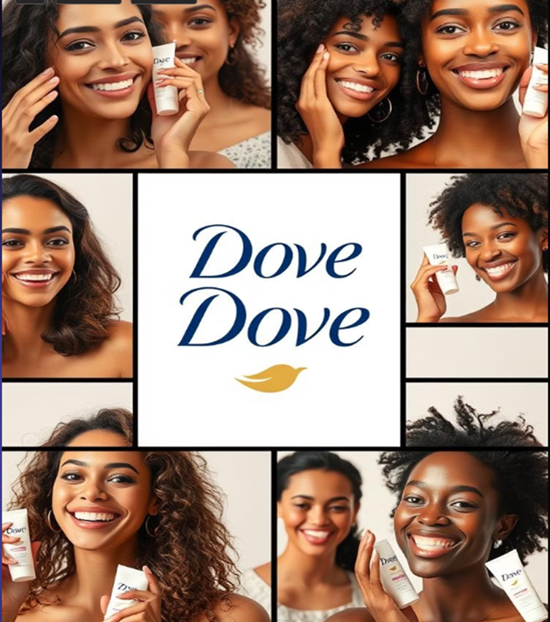
INTRODUCTION
Key Features of Dove Soap
This skincare product is designed for all skin types, including sensitive skin. It features a moisturizing formula with ¼ moisturizing cream to nourish the skin while maintaining its natural moisture barrier with a pH-balanced composition. Recommended by dermatologists, it provides gentle, soap-free cleansing that cleans without drying out the skin.

Slide 3


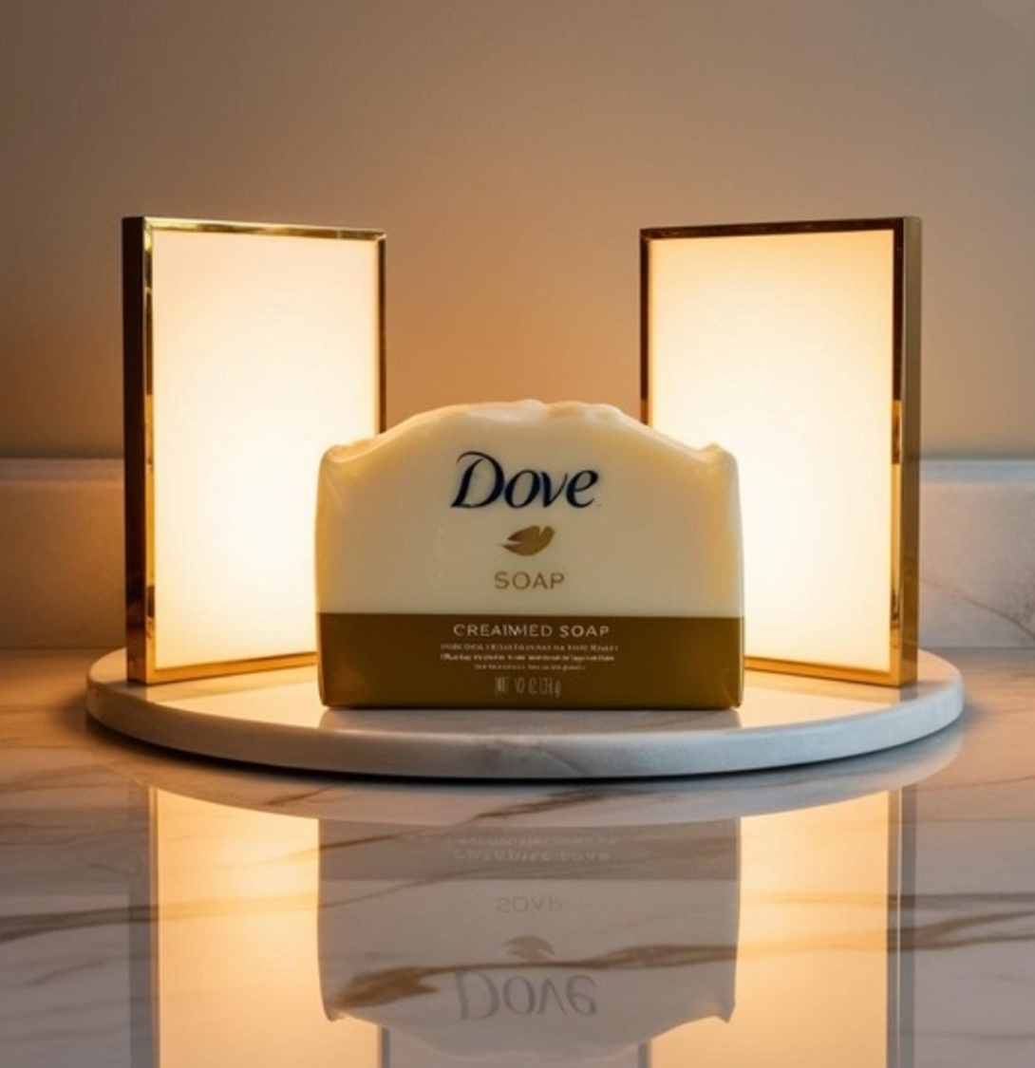
Dove is a globally recognized skincare brand owned by Unilever. It was first introduced with the Dove Beauty Bar, a unique cleansing bar formulated to be non-drying, unlike regular soaps. This product quickly gained popularity for its mild and moisturizing properties, making it ideal for all skin types, including sensitive skin.
Over the years, Dove has expanded its product line to include body washes, lotions, shampoos, conditioners, and deodorants, all designed to provide gentle care and nourishment. With a strong commitment to skin health and beauty, Dove is recommended by dermatologists and trusted by consumers worldwide.
Today, Dove is available in over 150 countries, making it one of the most widely recognized and respected skincare brands globally. The brand continues to emphasize moisturization, gentle cleansing, and skin-friendly formulations, setting it apart as a leader in the skincare industry.
1
2
3

Slide 4
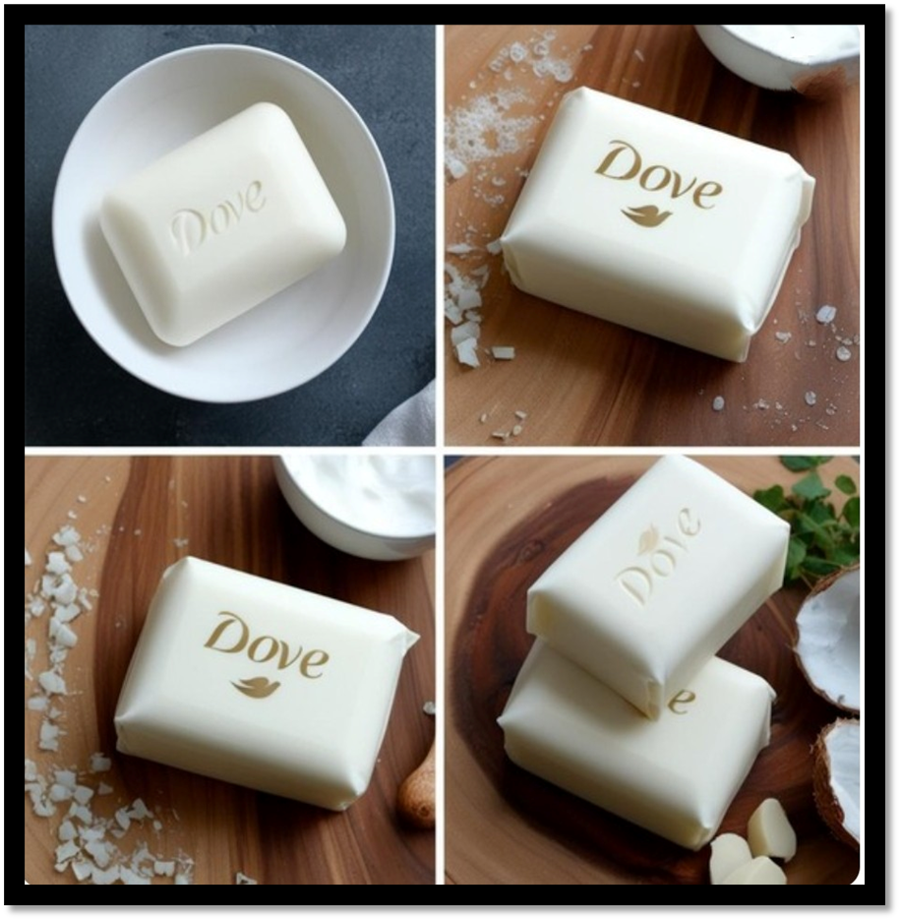
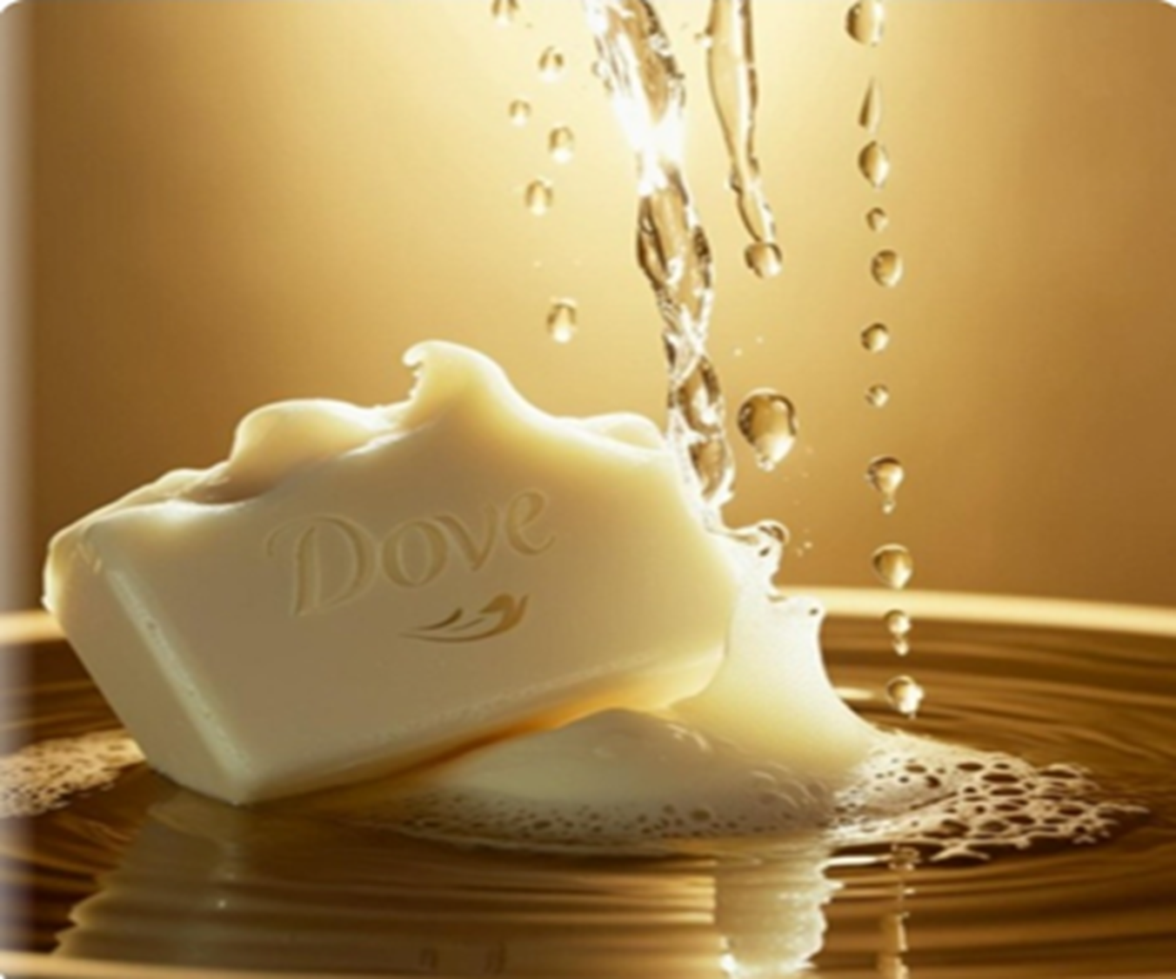
1. Campaign for Real Beauty (2004)
Objective:
Dove aimed to challenge traditional beauty standards and encourage self-confidence among women. The brand recognized that mainstream media often portrayed a narrow definition of beauty, focusing on unrealistic and unattainable standards. To counter this, Dove sought to redefine beauty by celebrating real women and promoting body positivity and self-acceptance.
Execution:
To achieve its mission, Dove launched the groundbreaking “Real Beauty” campaign, which became one of the most influential marketing initiatives in the beauty industry. Featuring Real Women Instead of Professional Models: Unlike conventional beauty advertisements that use airbrushed supermodels, Dove featured everyday women of different ages, body shapes, skin tones, and ethnicities. This approach aimed to make beauty more relatable, inclusive, and diverse.
Billboards and Commercials Celebrating Diversity:
Dove placed billboards, print ads, and digital commercials showcasing real women with different body types, facial features, and hair textures. These advertisements featured messages that challenged beauty stereotypes, such as “Wrinkled or Wonderful?” and “Gray Hair or Gorgeous?”, encouraging the audience to embrace their natural beauty.
Tagline:
“Real Women, Real Beauty” This powerful tagline reinforced the idea that beauty is not limited to unrealistic standards set by the fashion and cosmetic industries. It encouraged women to appreciate their natural appearance and feel confident in their own skin.
Impact & Success:
The Real Beauty campaign gained global recognition, sparking conversations about self-esteem, body image, and media representation. It received praise for its authentic messaging and commitment to changing beauty norms. The campaign also led to the creation of the Dove Self-Esteem Project, which educates young girls on body confidence and self-acceptance. Through this initiative, Dove successfully reshaped beauty advertising, proving that confidence and authenticity are the true definitions of beauty.

Slide 5

To bring its vision to life, Dove collaborated with top marketing and public relations firms to execute the “Real Beauty” campaign
effectively:
Advertising Agency: Ogilvy & Mather Dove partnered with Ogilvy & Mather, one of the world’s leading advertising agencies, to develop compelling and thought-provoking advertisements. The agency played a crucial role in crafting story-driven commercials, print ads, and billboard campaigns that resonated with audiences. Their creative approach emphasized authentic storytelling, using real women instead of models, and encouraging a positive body image.
Public Relations Firm:
Edelman, a globally renowned PR firm, helped shape the campaign’s message and spread it through various media outlets and public discussions. Edelman conducted research on women’s self-esteem and media influence, providing valuable insights that strengthened the campaign’s credibility. They ensured that the message reached a wide audience through press releases, media coverage, and social media engagement.
Impact of the Campaign :
Sparked Conversations on Unrealistic Beauty Standards The campaign challenged conventional beauty ideals, leading to widespread discussions about how the media portrays women. It encouraged people to rethink beauty norms and embrace diversity in appearance. The campaign was widely covered by news outlets, magazines, and social media, amplifying its reach.
Boosted Dove’s Sales and Brand Loyalty :
The campaign not only enhanced Dove’s reputation but also had a direct positive impact on sales. Studies showed that consumers appreciated the brand’s commitment to authenticity and inclusivity, leading to higher trust and brand loyalty. Dove’s revenue saw a significant increase, proving that purpose-driven marketing can translate into business success.

Slide 6
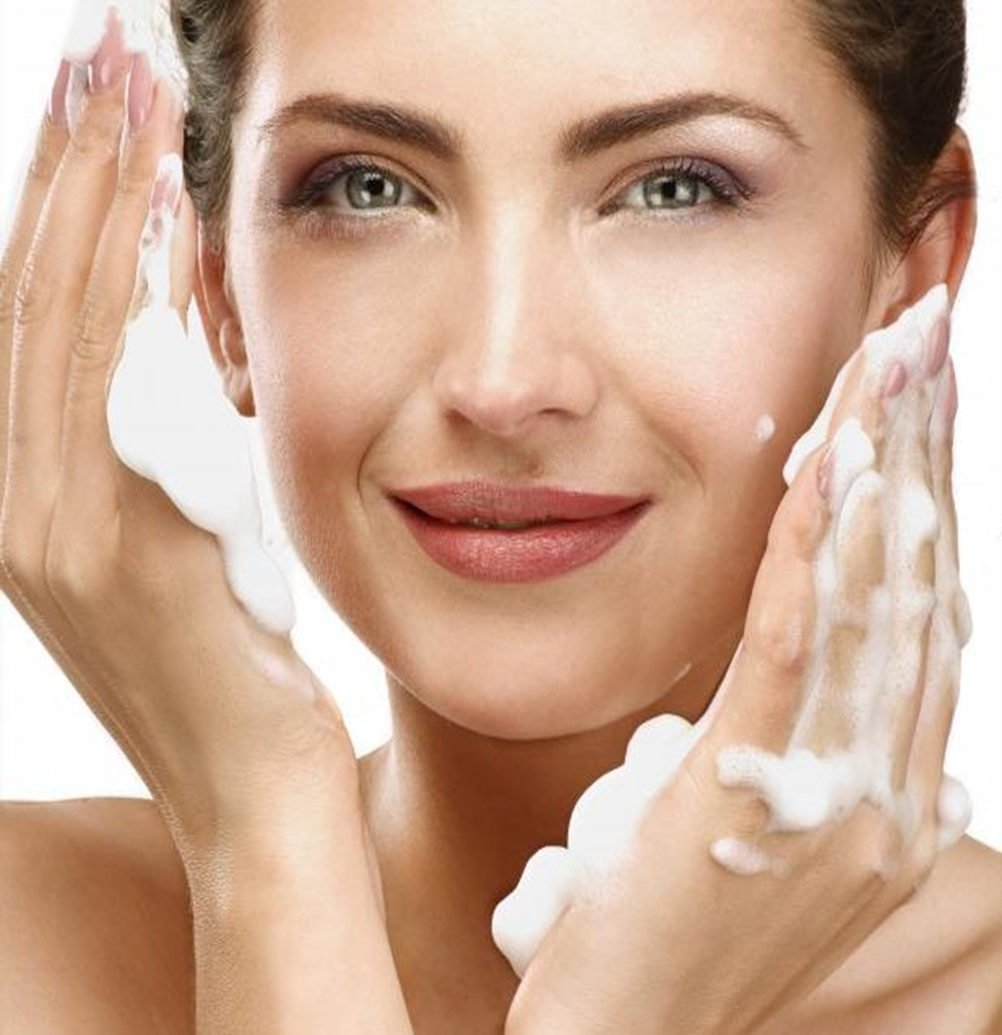
Dove’s “Evolution” Campaign (2006)
✨Objective:
To expose how digital retouching distorts beauty standards and promotes unrealistic ideals.
✨ Execution:
A viral video titled “Evolution” showed an ordinary woman transformed into a billboard model through makeup, lighting, and heavy Photoshop editing. It revealed how the beauty industry creates unattainable beauty expectations. The video ended with the message: “No wonder our perception of beauty is distorted.
✨”Impact:
Went viral, winning awards like the Cannes Lions Grand Prix. Sparked global conversations on beauty standards and media manipulation. Strengthened Dove’s brand identity as a champion of real beauty and self-confidence. Influenced the beauty industry, pushing brands to reduce excessive retouching. Dove’s Evolution campaign became a milestone in advertising, promoting authentic beauty and body positivity.

Slide 7

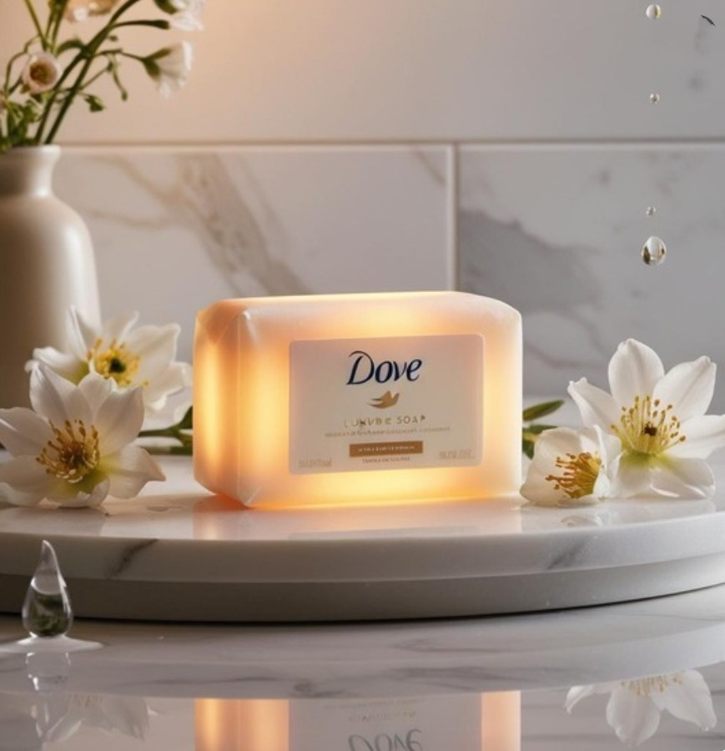
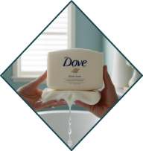
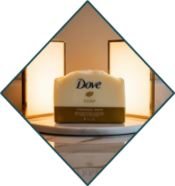
Dove’s “Evolution” Campaign – Collaboration & Impact
✨ Collaboration:
Dove partnered with Ogilvy & Mather, a renowned advertising agency, to create the “Evolution” video. Their expertise helped craft a powerful visual message exposing the unrealistic beauty standards set by the media.
✨ Impact:
Award-Winning Success: Won prestigious advertising awards, including the Cannes Lions Grand Prix, for its bold and impactful storytelling.
Sparked Industry-Wide Debates: The video triggered global discussions about the ethics of Photoshop in advertising, pushing brands to be more transparent.
✨ Encouraged Authentic Representation:
Many companies began reducing excessive retouching and embracing more natural portrayals of women in their marketing.
Dove’s Evolution campaign became a catalyst for change, influencing advertising practices and societal perceptions of beauty.

Slide 8


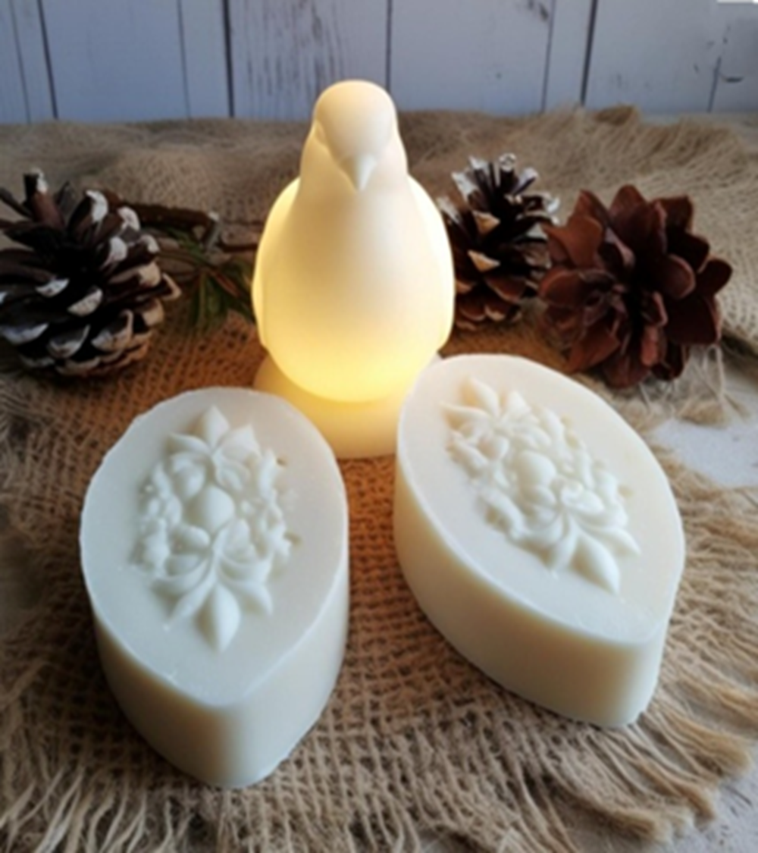
Dove’s #KeepHerConfident Beauty Bar (2024)
✨ Objective:
To support young girls' confidence in sports, addressing the issue of many quitting due to body image concerns.
✨ Execution:
Dove partnered with tennis legend Venus Williams to launch a limited-edition Beauty Bar promoting confidence in young female athletes.
Inspired by research showing that many girls drop out of sports due to self-esteem issues, the campaign aimed to encourage participation and break beauty-related barriers.
Proceeds from sales were used to fund sports programs for young girls, providing them with resources and support to stay in the game.
✨ Impact:
The #KeepHerConfident initiative reinforced Dove’s commitment to self-esteem and body positivity, empowering young girls to pursue sports without fear of judgment.
✨ Collaboration:
Venus Williams (Tennis Legend): A strong advocate for body positivity and female empowerment, she joined forces with Dove to inspire young girls to stay in sports despite societal pressures.
Black Girls Tennis Club: Partnered with Dove to promote body confidence in sports, providing support and resources for young female athletes.
✨ Impact:
Encouraged brands to invest in supporting female athletes and fostering a more inclusive sports environment.
Promoted self-confidence among young girls, reinforcing that sports should be about skill and passion, not body image concerns.

Slide 9

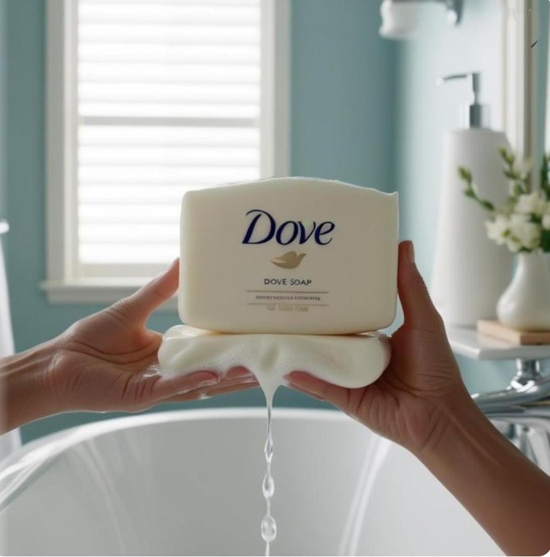
Beauty Never Gets Old (2024) – Dove's Campaign
Objective:
Dove aimed to challenge age-related beauty stereotypes by celebrating beauty at all ages, particularly focusing on women over 60. The campaign sought to break the societal obsession with youthful beauty and encourage confidence in aging.
Execution:
Dove featured real-life women over 60 who had been long-time users of Dove Beauty Bars. These women shared testimonials and personal stories about embracing their natural beauty with age. Instead of using models, Dove showcased authentic aging experiences, reinforcing the message that beauty is timeless.
Collaboration:
While Dove worked independently on this campaign, it partnered with influencers over 60. These influencers shared their journeys, spreading the message of self-acceptance and redefining beauty beyond youth.
Impact:
The campaign successfully shifted the narrative from youth-focused beauty standards to embracing aging with confidence. It empowered older generations, making them feel included in beauty conversations and encouraging self-love at every stage of life.

Slide 10

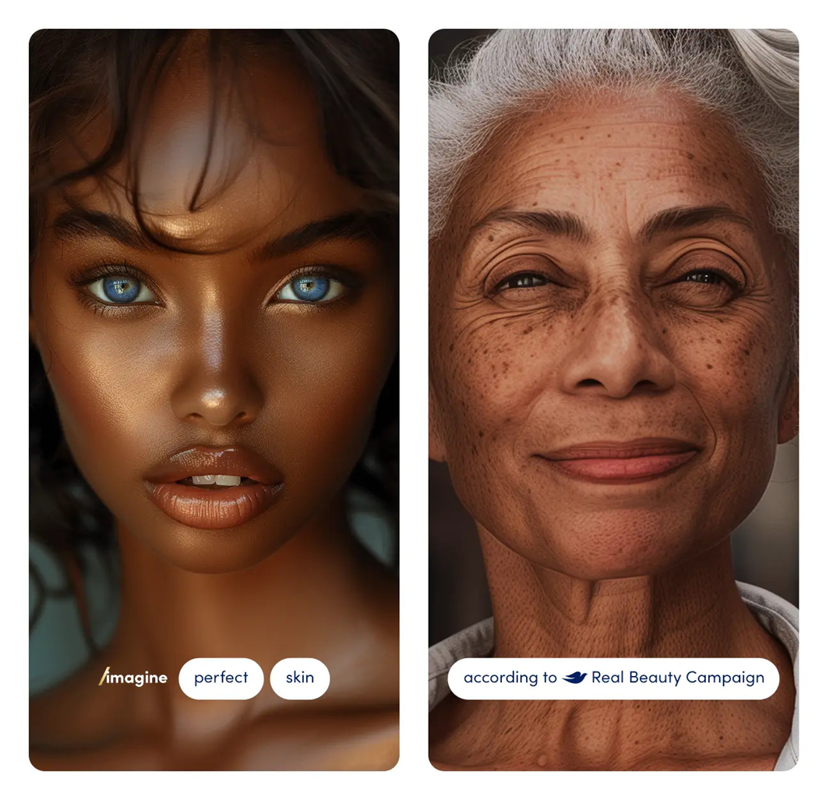
Dove’s "Real Beauty Pledge" (2024) Campaign
Objective:
Dove aimed to ensure authenticity in beauty representation by taking a firm stand against AI-generated beauty standards. As artificial intelligence became more prevalent in creating digitally perfected images, Dove sought to combat unrealistic beauty ideals and reinforce its commitment to natural beauty. The campaign focused on promoting real women in their genuine, unedited form, ensuring transparency and authenticity in beauty marketing.
Execution:
No AI-Generated Images: Dove publicly pledged never to use AI-created models or altered images in advertisements, ensuring that all featured women were real and untouched.
Commitment to Natural Beauty: The campaign reinforced Dove’s long-standing philosophy of celebrating diversity, self-acceptance, and true beauty without digital distortion.
Consumer Awareness: Dove educated audiences about the dangers of AI-manipulated beauty, emphasizing the importance of self-esteem and body confidence in the age of digital enhancement.
Collaboration:
Unilever’s Support: Dove’s parent company, Unilever, backed the pledge, extending the commitment to other brands under its umbrella. This reinforced the movement on a larger scale, setting new industry standards for authentic beauty marketing.
Impact:
Challenged AI-Driven Beauty Norms: By refusing to use AI-generated beauty, Dove stood against the industry’s increasing reliance on digital perfection.
Strengthened Brand Trust: Consumers recognized and appreciated Dove’s dedication to authenticity, reinforcing its reputation as a brand that genuinely values real beauty.
Industry Influence: Encouraged other brands to reconsider their use of AI-generated beauty standards, inspiring more transparency and inclusivity in advertising.

Slide 11

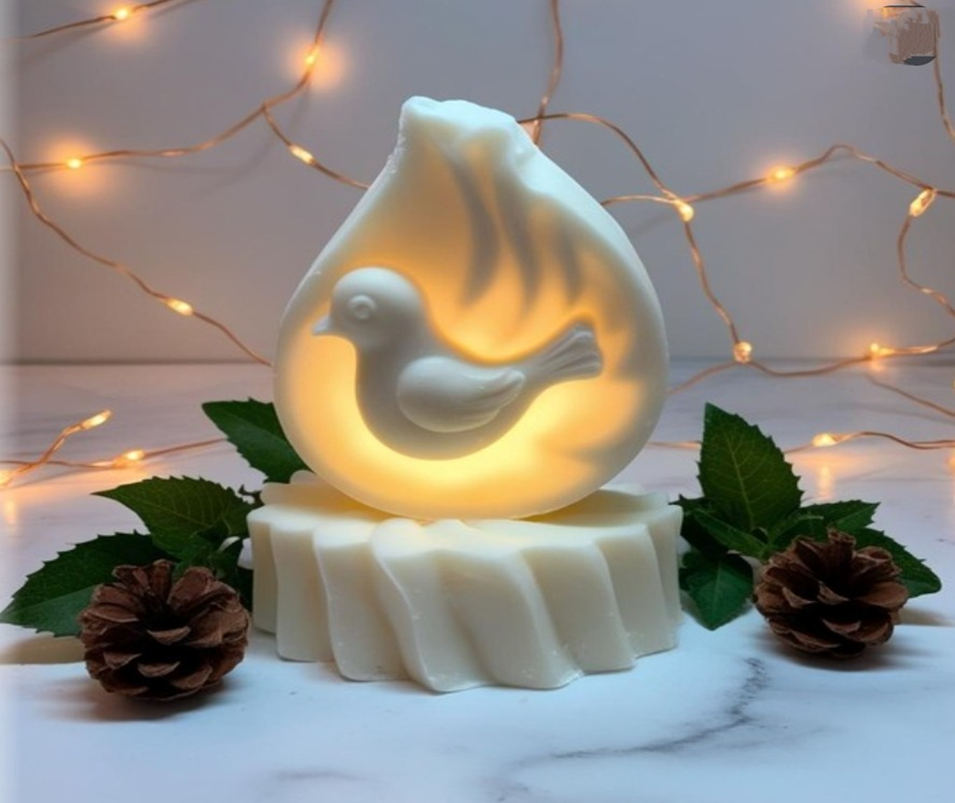
Other Key Collaborations by Dove:
1. Crumbl Cookies Collaboration (Dec 2024)
Dove partnered with Crumbl Cookies, a well-known gourmet cookie brand, to promote self-care and indulgence.
The collaboration likely featured limited-edition products, such as Dove-branded cookie packaging or gift bundles promoting self-love.
The message combined beauty and comfort, encouraging women to embrace self-care rituals that make them feel good inside and out.
2. Nike "Body Confident Sport" Program (Late 2023)
Partnered with Nike to promote body positivity and confidence in sports.
Aimed at breaking stereotypes that athleticism is tied to a specific body type.
Likely involved workshops, ambassador programs, and social media campaigns featuring real female athletes celebrating strength, resilience, and body acceptance.
3. NJ/NY Gotham FC Sponsorship (Feb 2025)
Became an official sponsor of NJ/NY Gotham FC, a professional women’s soccer team.
The partnership aligned with Dove’s mission of empowering women by supporting female athletes.
Reinforced the idea that beauty is not just about appearance but also about strength, performance, and confidence on and off the field.

Slide 12

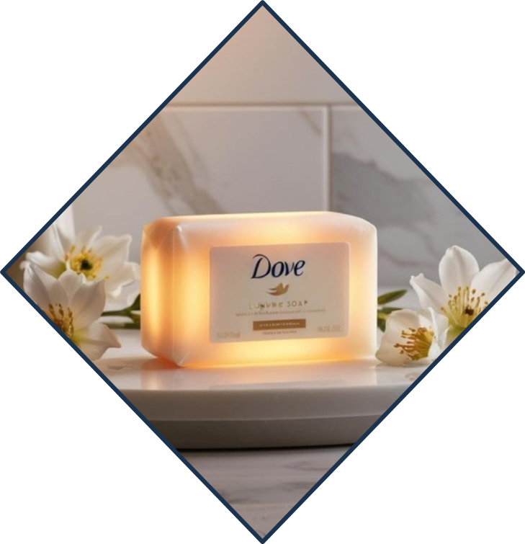

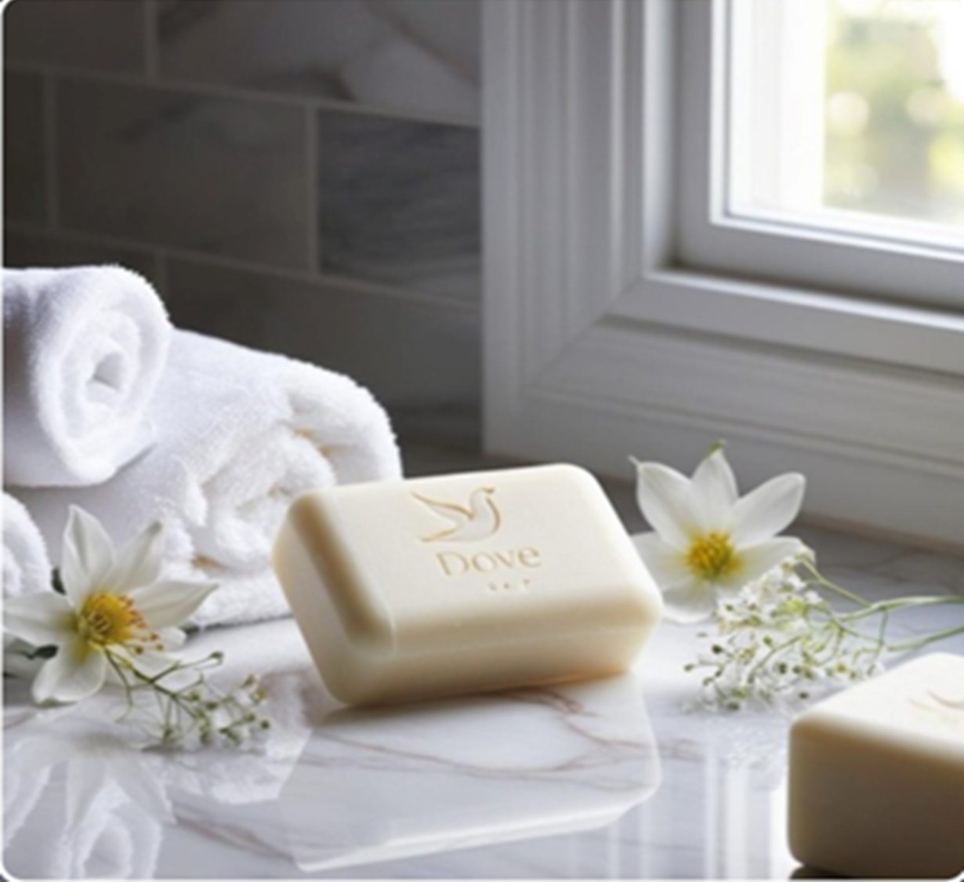
Conclusion
Dove’s "Real Beauty Pledge" positioned the brand as a leader in ethical beauty marketing by rejecting AI-manipulated beauty and promoting authentic representation. In an era of digital perfection, Dove reinforced self-confidence, inclusivity, and real beauty by featuring unedited, real women.
With Unilever’s support, the campaign challenged unrealistic beauty standards and inspired industry-wide change. By prioritizing transparency and empowerment, Dove strengthened consumer trust and proved that true beauty doesn’t need digital enhancement—it thrives in authenticity.
VISIT US

